Slide 1

I Don't Like Notebooks
Joel Grus (@joelgrus) #JupyterCon 2018
Notes:
hi, I'm Joel, and I don't like notebooks

Slide 2

Notes:
it's likely I'm the only one at this conference, but out in the real world there are dozens of us

Slide 3
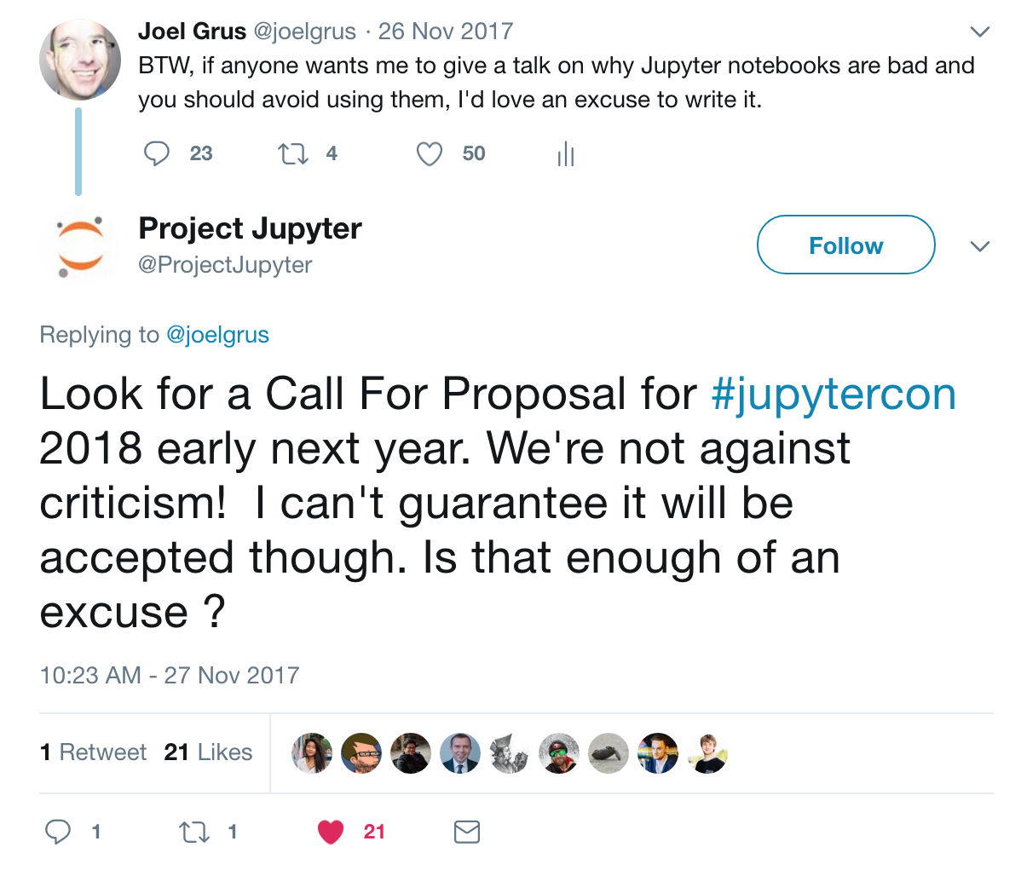
how we
ended up
here
@joelgrus #jupytercon
Notes:
how did we end up here?
I was angry about notebooks
I rage-tweeted that I wanted to give a talk about it
I guess someone was listening

Slide 4
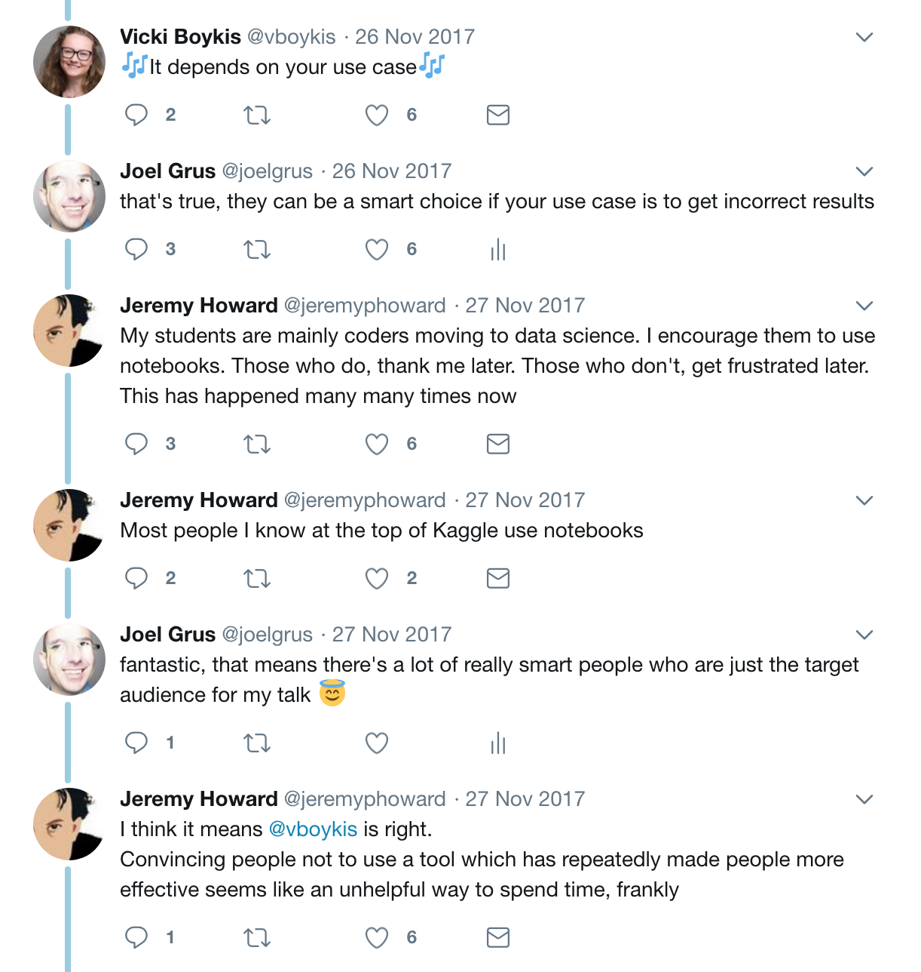
the idea was received pretty warmly
@joelgrus #jupytercon
Notes:
data science luminaries thought it sounded like "an unhelpful way to spend time"

Slide 5

about me
@joelgrus #jupytercon
Notes:
so, what kind of person not only doesn't like notebooks but goes to a conference about notebooks to talk about how he doesn't like notebooks?

Slide 6


research engineer @ Ai2
@joelgrus #jupytercon
Notes:
I'm a research engineer at the Allen Institute for Artificial Intelligence
my job is Python, library design, and reproducible science
so I have a few thoughts on those topics

Slide 7


know a few things about python
@joelgrus #jupytercon
Notes:
I won't call myself a Python "expert"
(never call yourself an "expert")
but I'm pretty good at Python
I've been using it for many, many years
and I have many strong opinions about how to code in Python

Slide 8
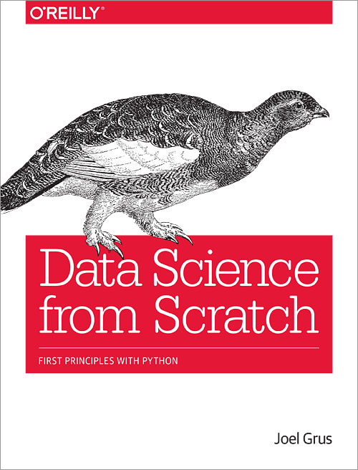
know a few things about data science
@joelgrus #jupytercon
Notes:
was Chief Data Scientist at VoloMetrix (acquired by Microsoft)
have managed and mentored data scientists
wrote a popular book on data science -->
second edition coming soon!
Python 3.6
type hints
deep learning
better code
new chapter "I Don't Like Notebooks"
and many other improvements

Slide 9
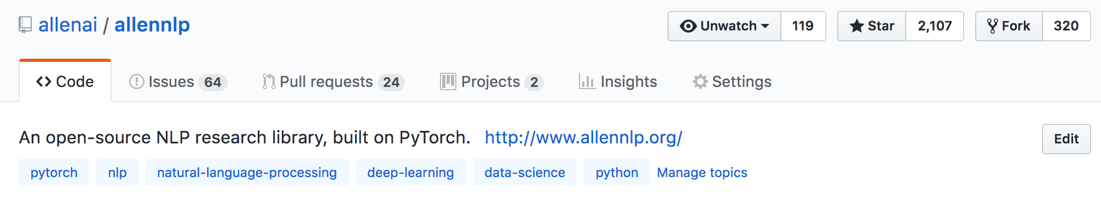
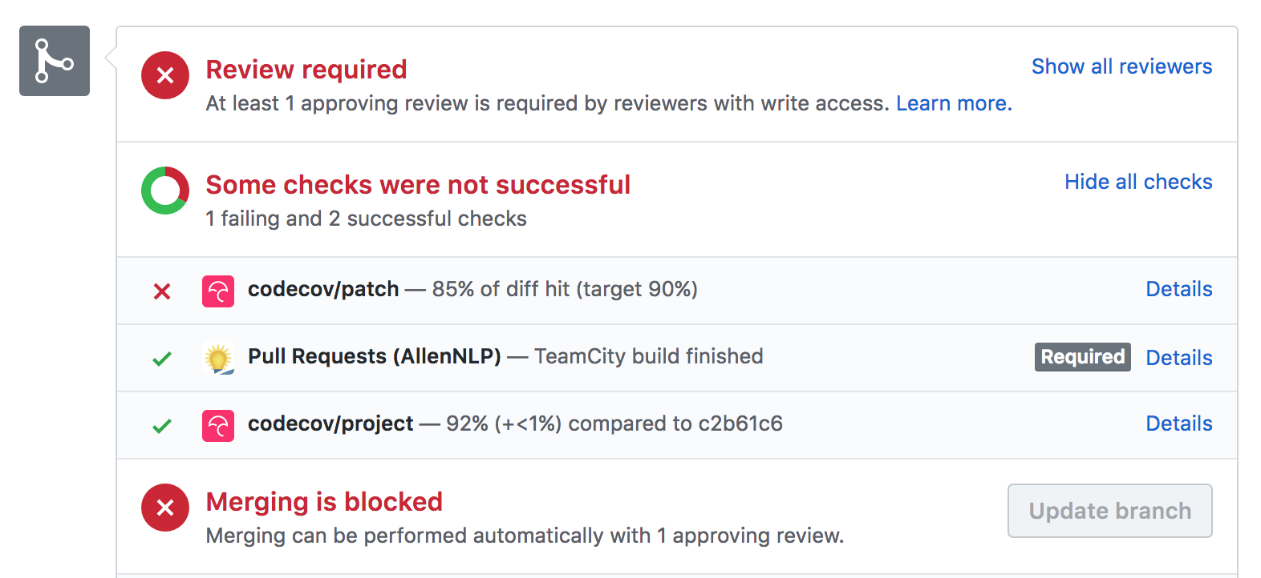
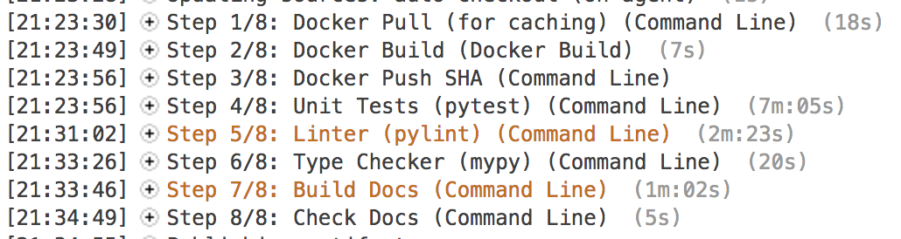
know a few things about software engineering
@joelgrus #jupytercon
Notes:
spent a couple of years as a SWE at Google
currently a core engineer on AllenNLP
(which is very well engineered)

Slide 10
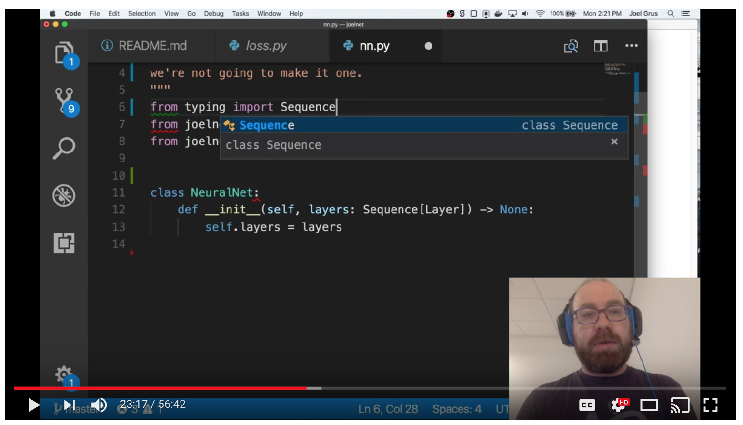
livecoder
@joelgrus #jupytercon
Notes:
I make livecoding videos, so I think a lot about how to illustrate concepts with code

Slide 11
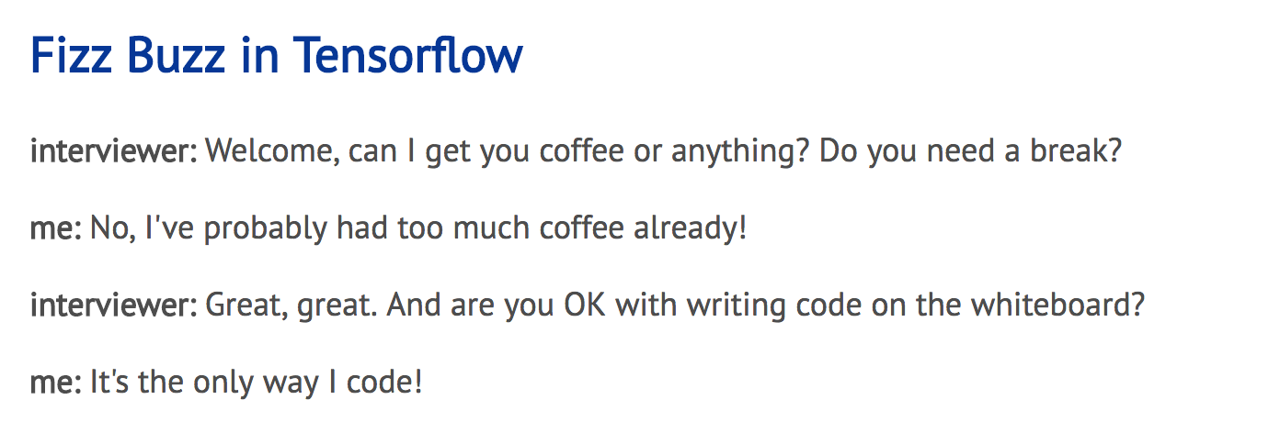
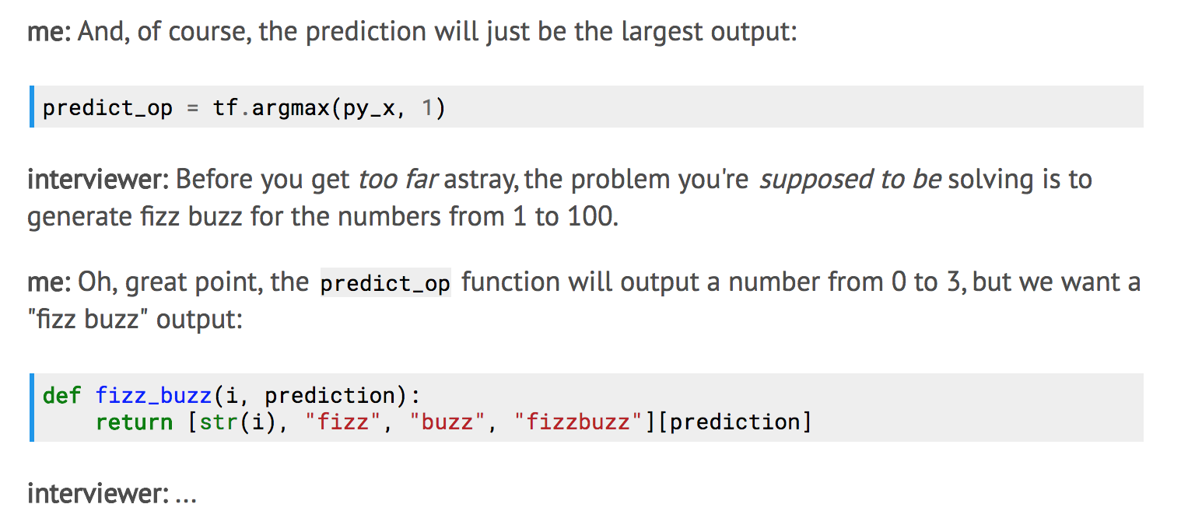
blogger
...
@joelgrus #jupytercon
Notes:
sometimes I blog about Python

Slide 12

podcast co-host
@joelgrus #jupytercon
Notes:
and I co-host a podcast with Andrew Musselman
yes, I know it's been a while since we released an episode, that's my fault, I need to edit them

Slide 13

what I assume about
you
@joelgrus #jupytercon
Notes:
that's me, what about you
I assume since you're at this conference you think that notebooks are great
I assume since you're at this talk you want me to change your mind
https://i.imgflip.com/2ajw0u.jpg

Slide 14
a couple of caveats
@joelgrus #jupytercon
Notes:
a couple of things

Slide 15

@joelgrus #jupytercon
Notes:
I have tried very hard not to misrepresent notebooks
but it's possible that I have done inadvertently
anyway, I have a lot of criticisms, so even if one is off base they can't all be
also, it's possible (even likely) that there are e.g. complicated add-ins that I don't know about that address some of my concerns
this talk is generally about notebooks as most people use them in practice, because that's all I really know

Slide 16
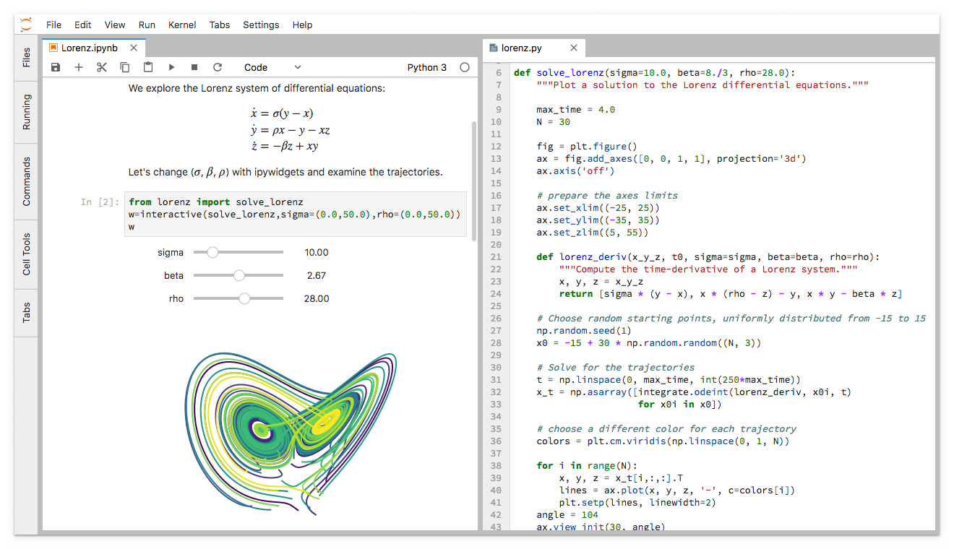
Notes:
in addition, there is a new product called jupyterlab
it was not released when I proposed this talk
I haven't spent a lot of time with it
most of the talk is about classic notebooks
maybe jupyterlab addresses some of my concerns

Slide 17
things I do like about notebooks
@joelgrus #jupytercon
Notes:
before I get into my complaints, it's only fair to talk about the things I do like about notebooks

Slide 18
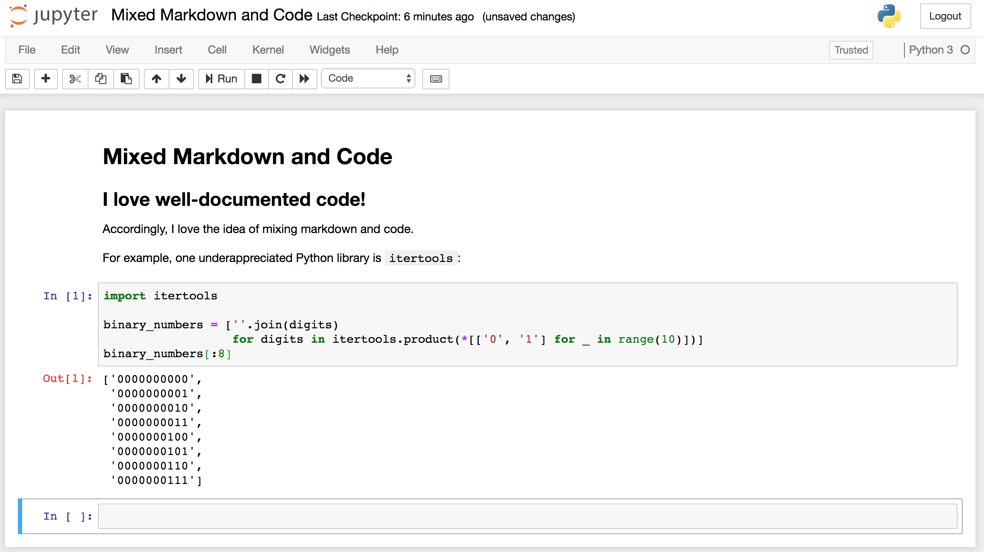
@joelgrus #jupytercon
Notes:
I love well-documented code, and so I love the idea of interspersing markdown with code blocks

Slide 19
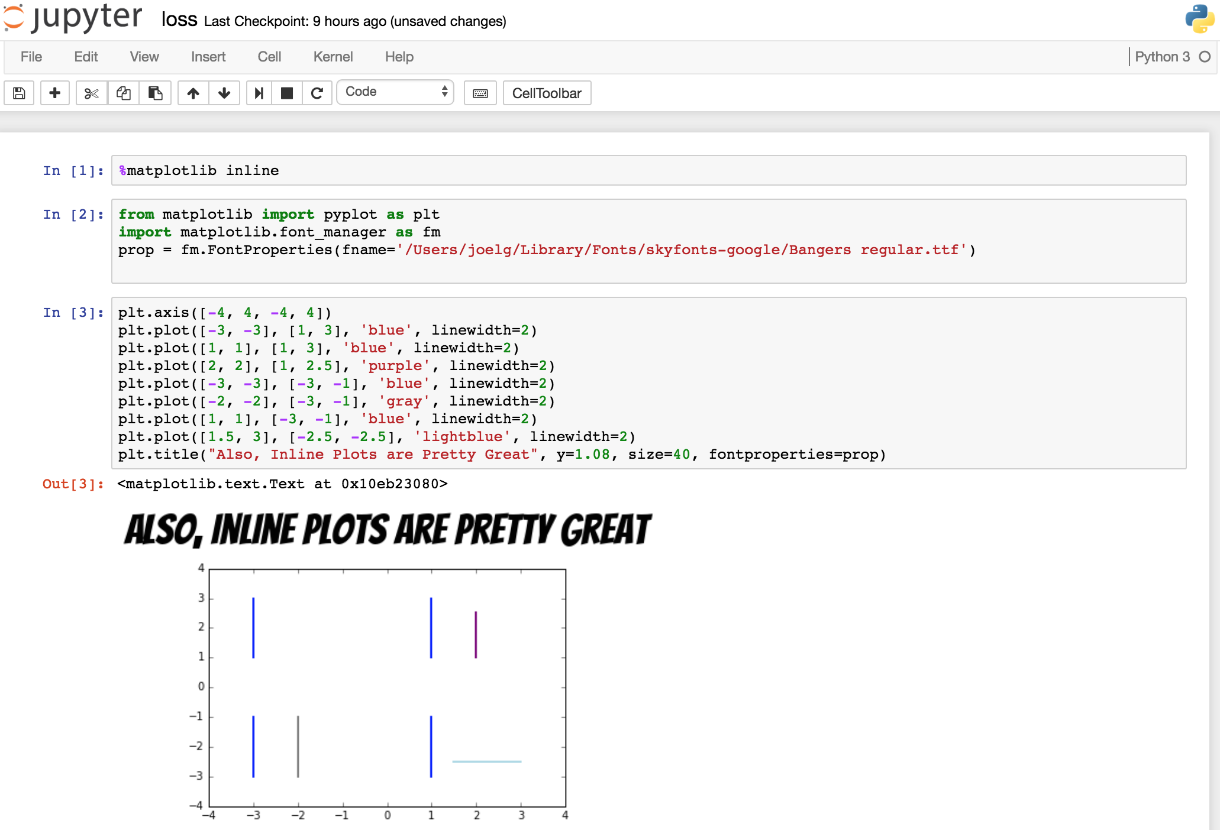
@joelgrus #jupytercon
Notes:
also, inline plots are pretty great
the story around plotting in the python console is not good

Slide 20
things I don't like about notebooks
@joelgrus #jupytercon
Notes:
ok, so now let's talk about the things I don't like about notebooks

Slide 21

notebooks have tons and tons of hidden state that's easy to screw up and difficult to reason about
@joelgrus #jupytercon
Notes:
this is my #1 complaint
notebooks have tons of hidden state that's easy to screw up and difficult to reason about
https://i.gifer.com/1CX7.gif

Slide 22
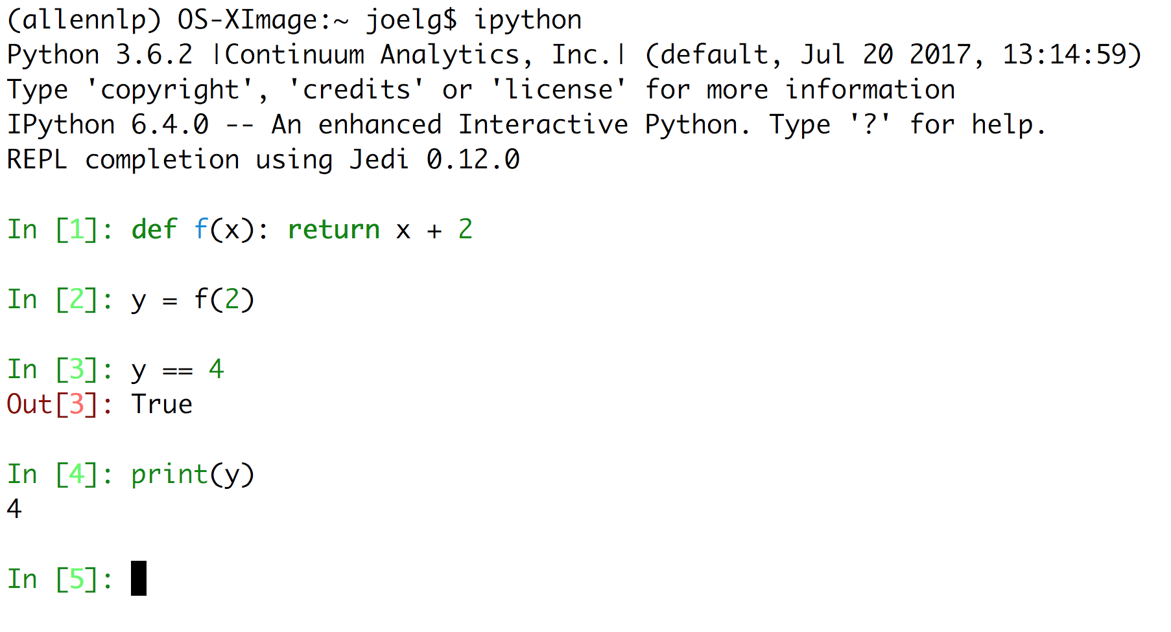
simple example
@joelgrus #jupytercon
Notes:
ok, so here's some really simple python.
I define a function f that adds two to a number
I call that function on 2
I expect the result to be 4

Slide 23
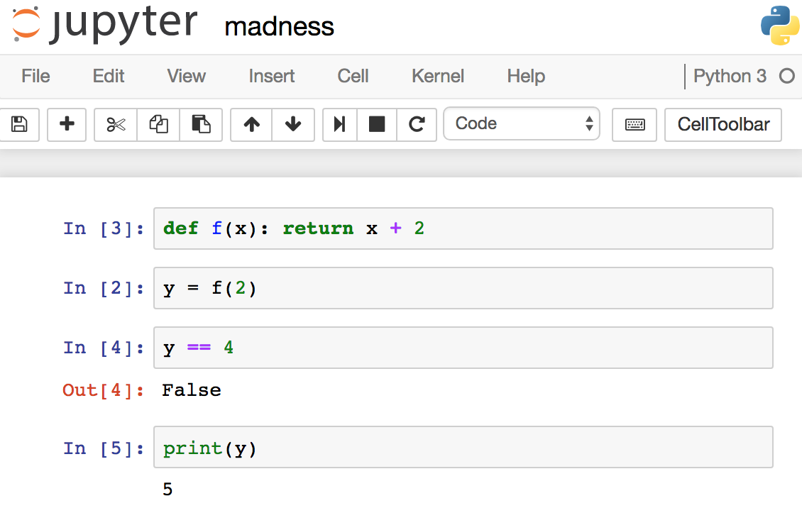

if you look at the numbers, it's clear those cells weren't even executed in order!
@joelgrus #jupytercon
Notes:
so here's that same code in a notebook
except that it doesn't work
because I ran the cells out of order
and there's a missing [1] and who knows what it was

Slide 24
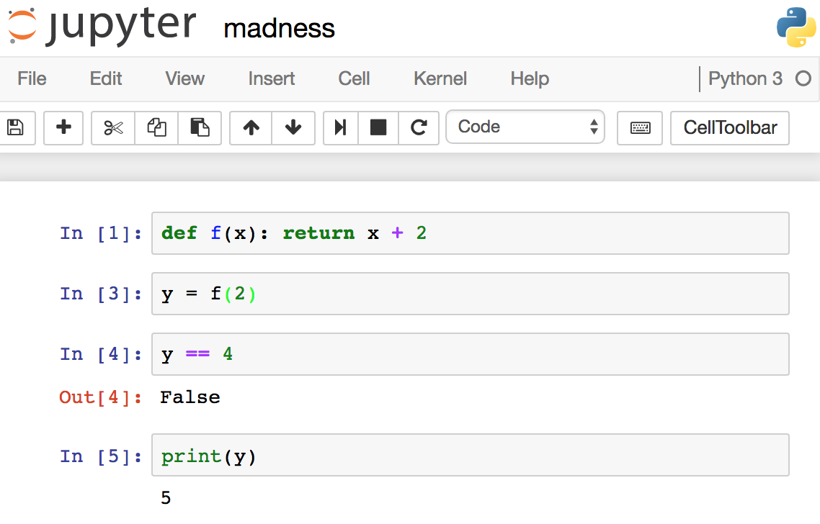
if you look at the numbers, it's clear that something else was run between the first two lines
@joelgrus #jupytercon
Notes:
ok, here's another attempt, this one also doesn't work
because there's some computation that ran between the first two cells that I can't see

Slide 25
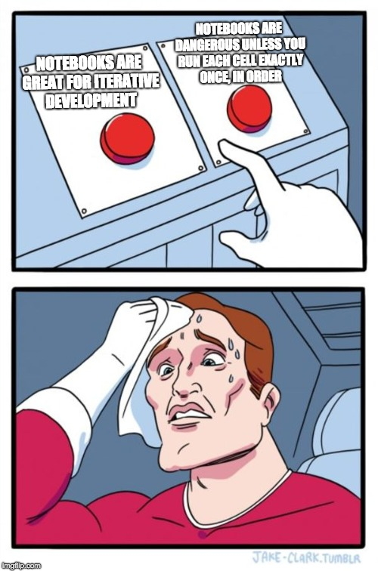
@joelgrus #jupytercon
Notes:
so, you know, on one hand one of the pitches for notebooks is that they're great for iterative development
on the other hand they're dangerous and confusing unless you run the cells precisely in order
https://i.imgflip.com/2egqlc.jpg

Slide 26
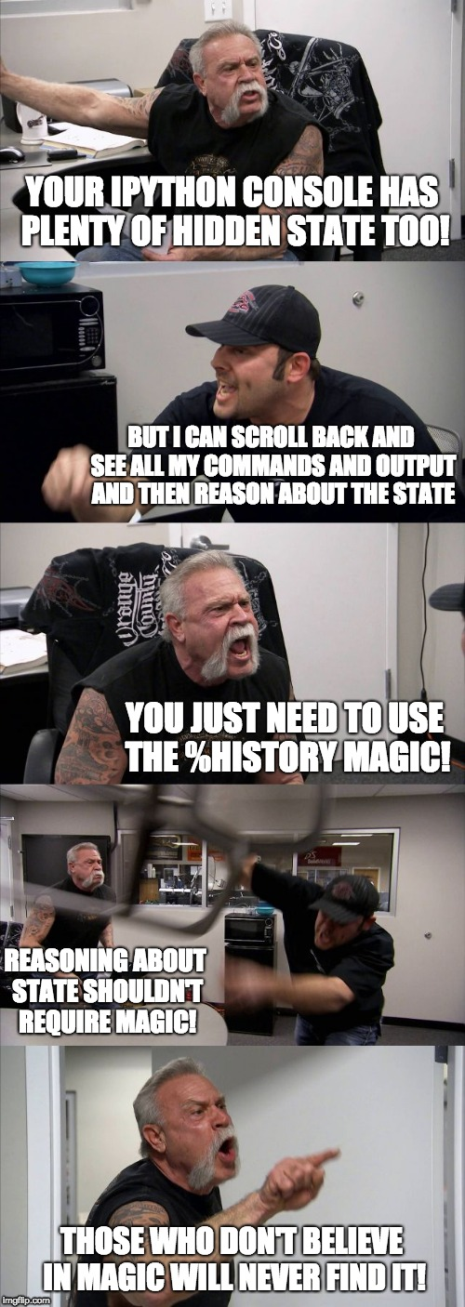
@joelgrus #jupytercon
Notes:
some of you are thinking that my REPL has plenty of hidden state too

Slide 27
@joelgrus #jupytercon
Notes:
which it does, but that state was built up in a linear fashion, which I can see just by scrolling back in my terminal

Slide 28
@joelgrus #jupytercon
Notes:
yes, I can see the history of commands if I go out of my way and use %history magic in a cell

Slide 29
@joelgrus #jupytercon
Notes:
but reasoning about state is one of the hardest parts of coding, and so we try should make it as easy as possible for people

Slide 30
@joelgrus #jupytercon
Notes:
not as difficult as possible

Slide 31
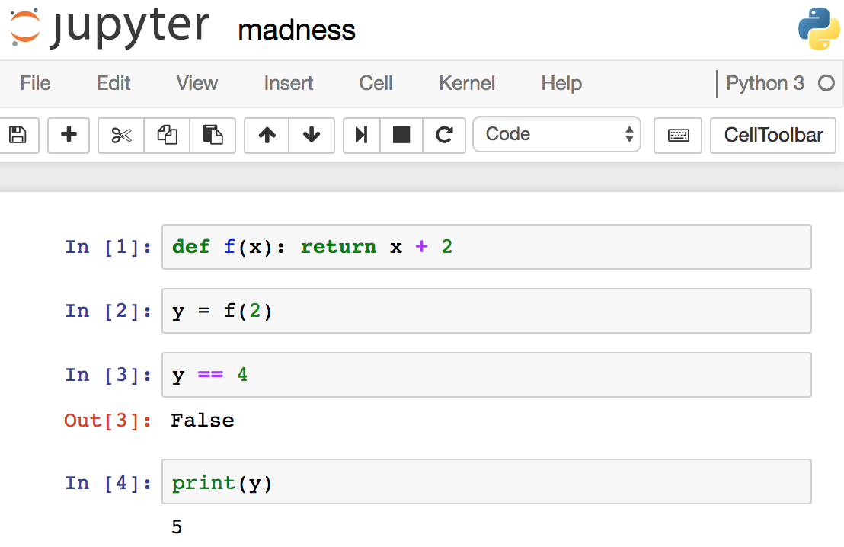

one more
...
@joelgrus #jupytercon
Notes:
here's another one
this is real, I didn't photoshop it or hack the HTML or anything

Slide 32
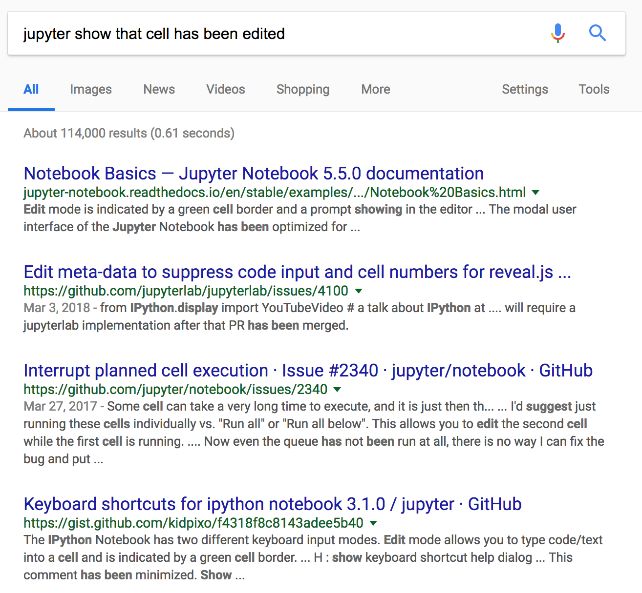

oops!
@joelgrus #jupytercon
Notes:
I just edited the first cell and didn't execute it
I did this on purpose, but you could certainly do that by accident as well

Slide 33

notebooks are difficult for beginners
@joelgrus #jupytercon
Notes:
my second gripe is that notebooks are difficult for beginners

Slide 34

Start off by creating a notebook.
@joelgrus #jupytercon
Notes:
someone comes to you wanting to get started in python
and you tell them to use notebooks, but…
https://media.giphy.com/media/TvL78zj3pZ0yY/giphy.gif

Slide 35

(hidden state complications are not obvious)
@joelgrus #jupytercon
Notes:
the sorts of hidden state complications I'm unhappy about are not obvious

Slide 36
this is most people's experience of how code works
the ability to run code snippets in arbitrary order is weird and unintuitive
@joelgrus #jupytercon
Notes:
this is most people's experience of how code works
the ability to run bits of code in arbitrary order is weird

Slide 37
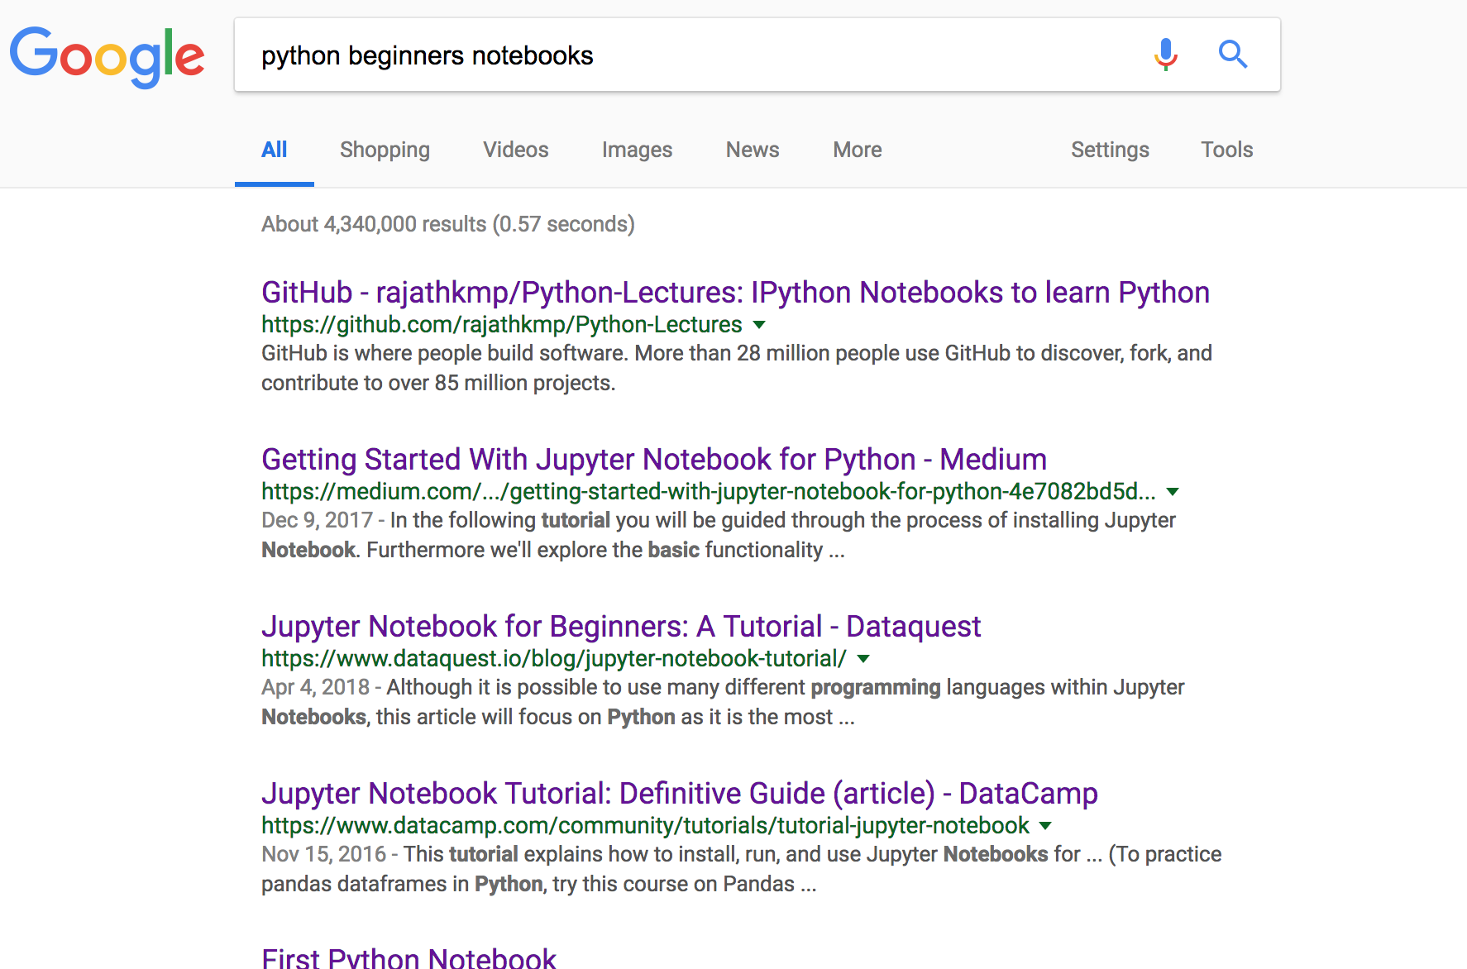
beginner tutorials are cavalier about (or silent on) hidden state
@joelgrus #jupytercon
Notes:
so I went looking for beginner guides to see what they have to say on the issue
I didn't cherry pick, these examples are all from the first page of google results
https://www.google.com/search?q=python+beginners+notebooks&oq=python+beginners+notebooks&aqs=chrome..69i57.4975j0j1&sourceid=chrome&ie=UTF-8

Slide 38
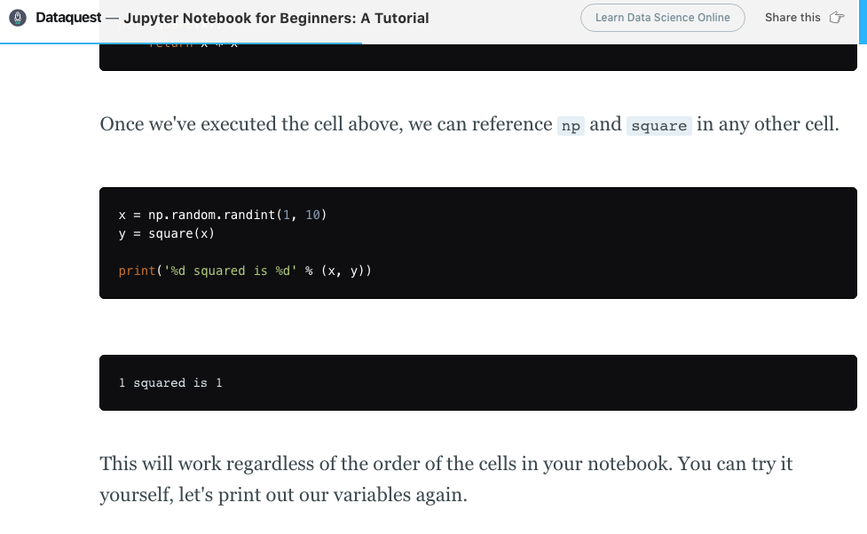
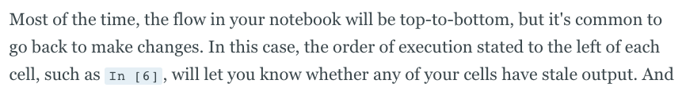
@joelgrus #jupytercon
Notes:
dataquest, to their credit, mentions the issue
although they simply tell you that "this will work regardless of the order of the cells"
not "DON'T RUN YOUR CELLS OUT OF ORDER YOU FOOL"
then they casually mention that you should keep an eye on the order of execution markers
if your notebook is longer than a single screen? :shrug:
https://www.dataquest.io/blog/jupyter-notebook-tutorial/

Slide 39
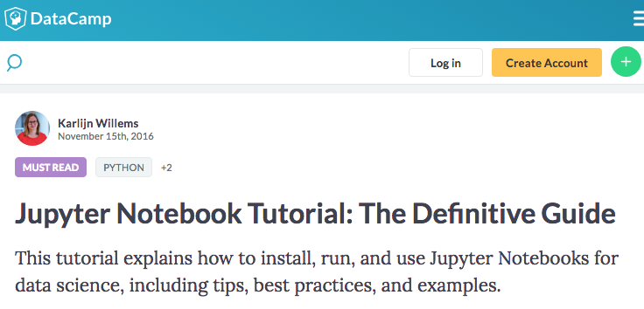

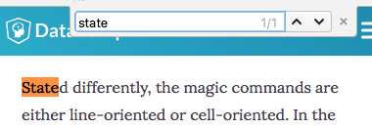




@joelgrus #jupytercon
Notes:
this is the _definitive guide_
it doesn't mention the issue
https://www.datacamp.com/community/tutorials/tutorial-jupyter-notebook

Slide 40
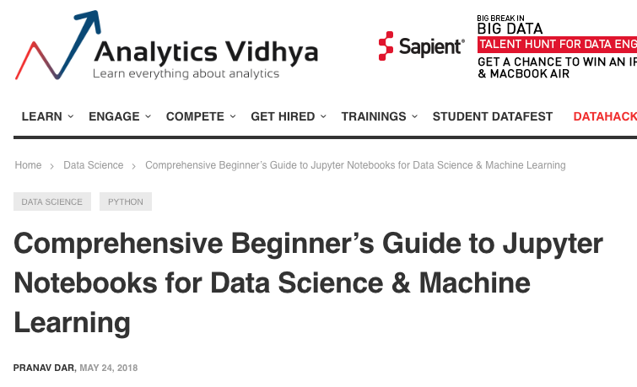
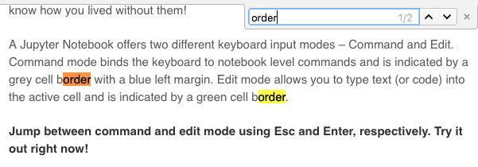
@joelgrus #jupytercon
@joelgrus #jupytercon
Notes:
this is the comprehensive beginners guide
it also doesn't mention the issue
https://www.analyticsvidhya.com/blog/2018/05/starters-guide-jupyter-notebook/

Slide 41
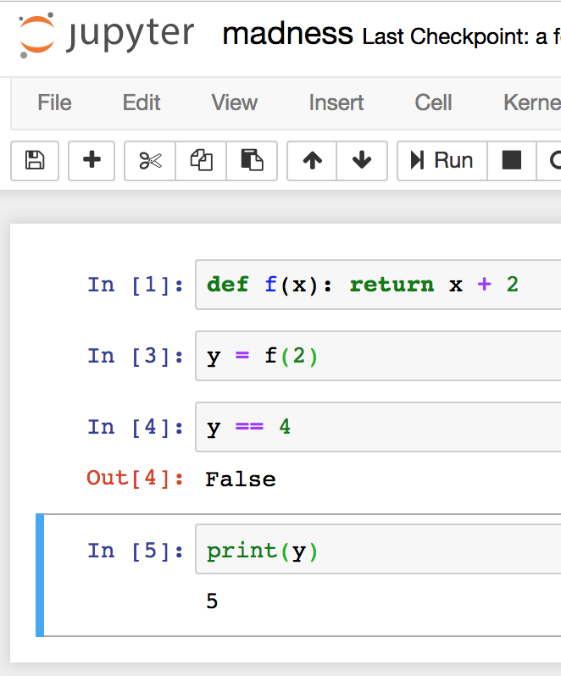
as notebook experts, the problem here is obvious to you
(also this is a really simple example)
for beginners, with dozens of cells and more complex code, this is utterly confusing
(I know this because they come to me with their problems)
@joelgrus #jupytercon
Notes:
back to our original example

Slide 42
in fact, my original angry tweet was prompted by the [large number]^{th} occasion of me helping a newcomer to python who used a notebook because they heard that was *the thing to do* and who found "python" bewildering 100% on account of messed up hidden state in their notebook due to normal beginner sloppiness and out-of-order execution
@joelgrus #jupytercon
Notes:
in fact, the tweet that launched this talk was based on me being angry after yet another instance of helping a python newcomer who had gotten utterly confused by the cocked-up state in their notebook

Slide 43
Lots of beginners use notebooks; clearly it can't be that difficult.
It's not that it's insurmountably difficult, it's that the out-of-order execution makes learning Python more confusing than it needs to be.
@joelgrus #jupytercon
Notes:
you might be thinking that lots of beginners use notebooks, so they can't be that confusing
I'm saying they make getting started more confusing than it needs to be
by adding an extra source of complexity and errors

Slide 44

notebooks encourage bad habits
@joelgrus #jupytercon
Notes:
writing good code is largely about developing good habits
but notebooks encourage bad habits

Slide 45
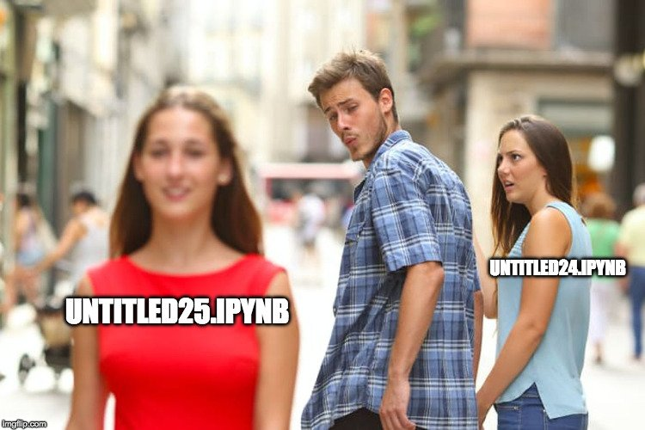
@joelgrus #jupytercon
Notes:
you know you have folders full of these
even I have folders full of these

Slide 46
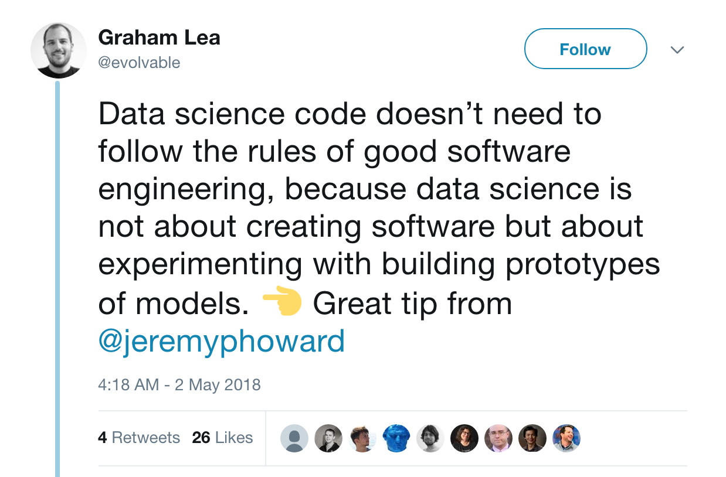
apparently this was a slight misrepresentation of the "tip", although I didn't learn that until after I started a Twitter war over it
@joelgrus #jupytercon
Notes:
notebooks don't have to encourage bad habits, but this is what we're up against
at least, this is what I'm up against, for all I know you may be for this
but this tweet is the antithesis of me
if you take one thing away from my talk, it's that data science should follow the rules of good software engineering!

Slide 47
Rigorous software engineering isn't that important, I'm just experimenting!
You mean you're just
doing science?
@joelgrus #jupytercon
Notes:
there is a mindset that says that "good engineering" is only for "production code"

Slide 48
I just want to see if my model works before I put it into production.
Don't you need to write correct code to make sure it works?
@joelgrus #jupytercon
Notes:
and that it's fine to be sloppy when you're just trying things out

Slide 49
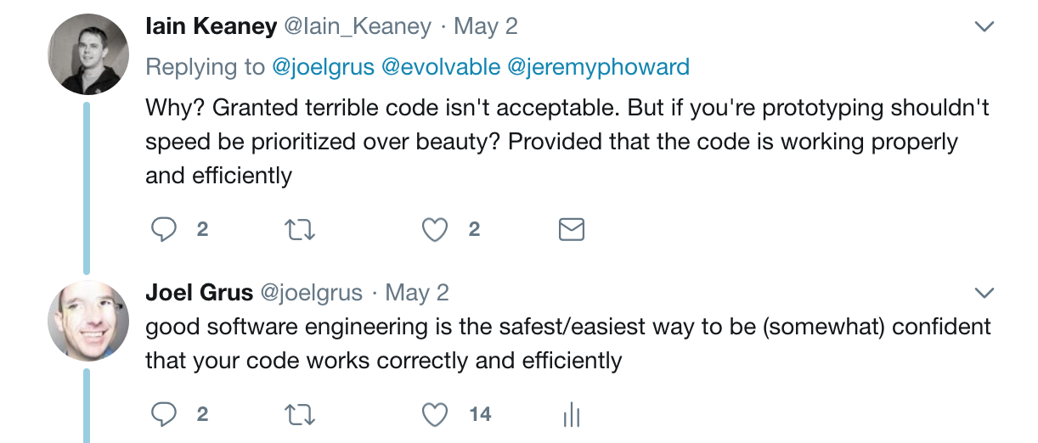
anti-pattern: the need for speed
@joelgrus #jupytercon
Notes:
sometimes this is justified as that it's important to write code as fast as possible
and that not following software engineering best practices facilitates that, QED
I don't necessarily agree that that's the case,
but also unless you're doing some kind of livecoding stunt you should be way more concerned about coding well than coding fast
if you have a job that requires otherwise, I encourage you to look for a better one

Slide 50
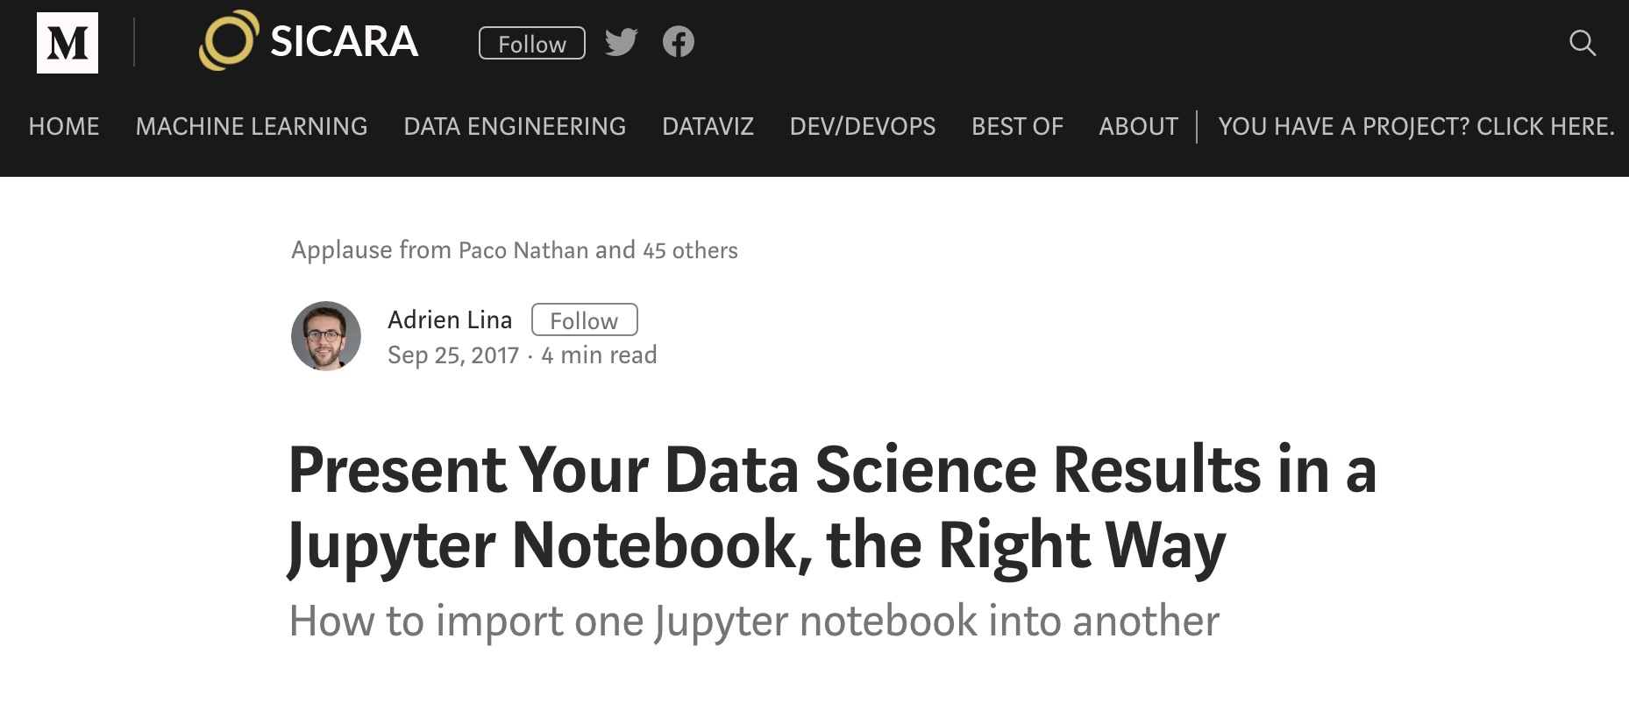
@joelgrus #jupytercon
Notes:
as an outsider I get the impression that a lot of the jupyter ecosystem
consists of tools to work around people's bad habits so they don't have to fix them
here's a blog post that I think I came across on Twitter
how to use jupyter notebooks "the right way"
it's a random post, but it does have applause from Paco
https://blog.sicara.com/present-data-science-results-jupyter-notebook-import-into-another-108433bc8505

Slide 51
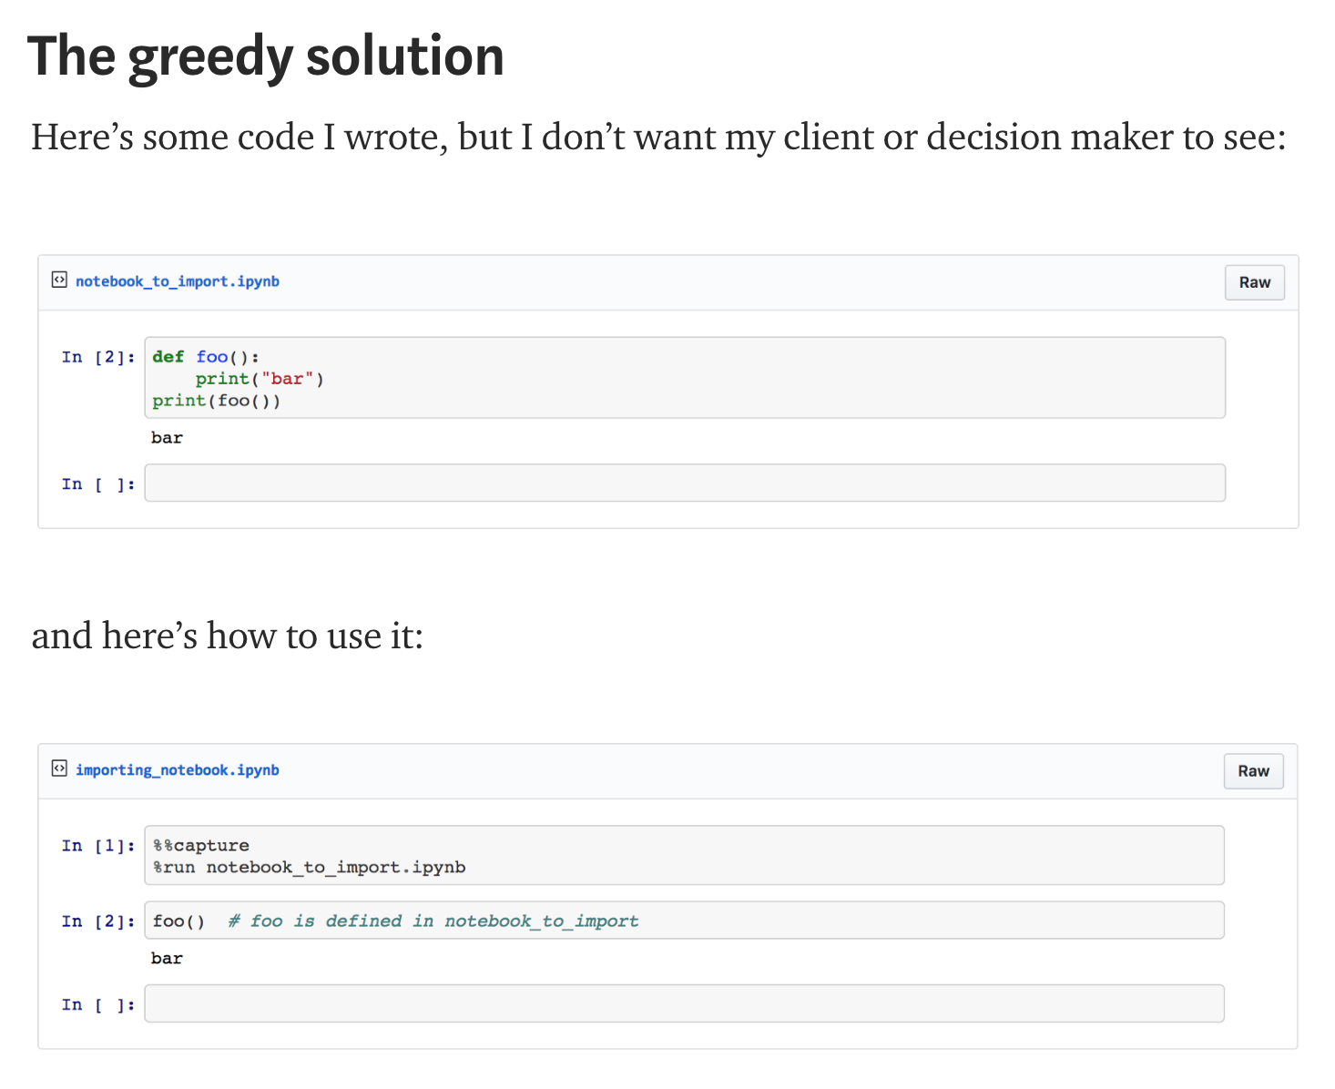
@joelgrus #jupytercon
Notes:
so, you have a function whose details you don't want in your final output

Slide 52
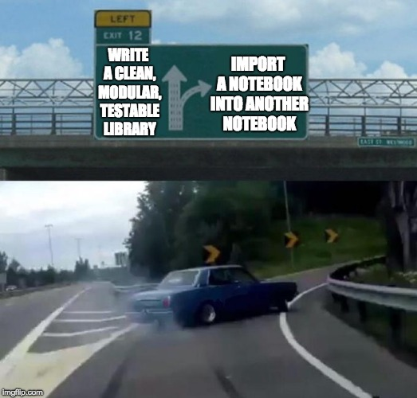
"Here's some code I wrote, but I don't want my client or decision maker to see"
@joelgrus #jupytercon
Notes:
which, it turns out, is already a solved problem
https://i.imgflip.com/2e0pj4.jpg

Slide 53
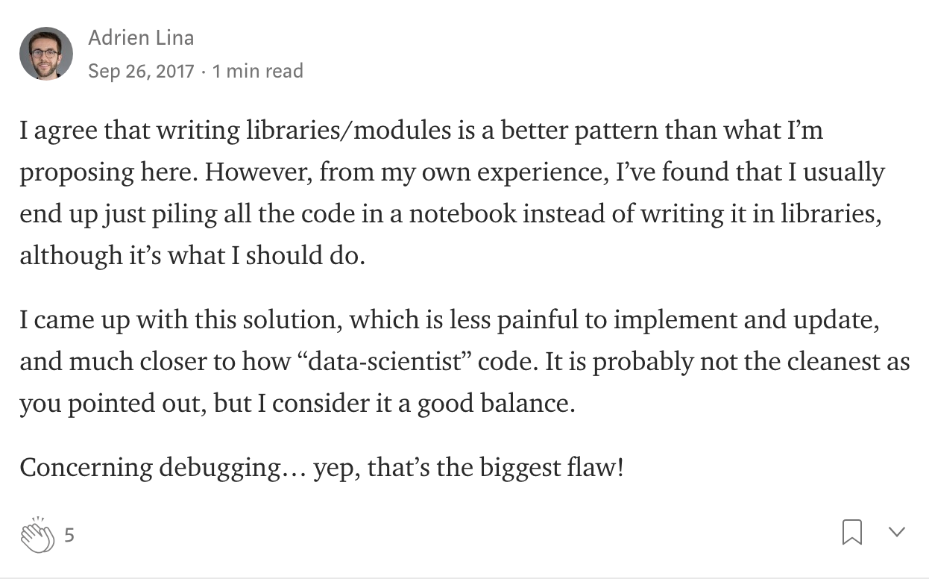
@joelgrus #jupytercon
Notes:
in the comments, people raised this issue
the author acknowledged that his recommendations were not good, but that they were second-best given that data scientists write crap code
nonetheless, the blog post is still titled "the right way"
and it's not like this way is even any faster

Slide 54

notebooks discourage good habits
@joelgrus #jupytercon
Notes:
not only do notebooks encourage bad habits, they also discourage good ones
https://i.makeagif.com/media/4-24-2016/vC9Rf-.gif

Slide 55

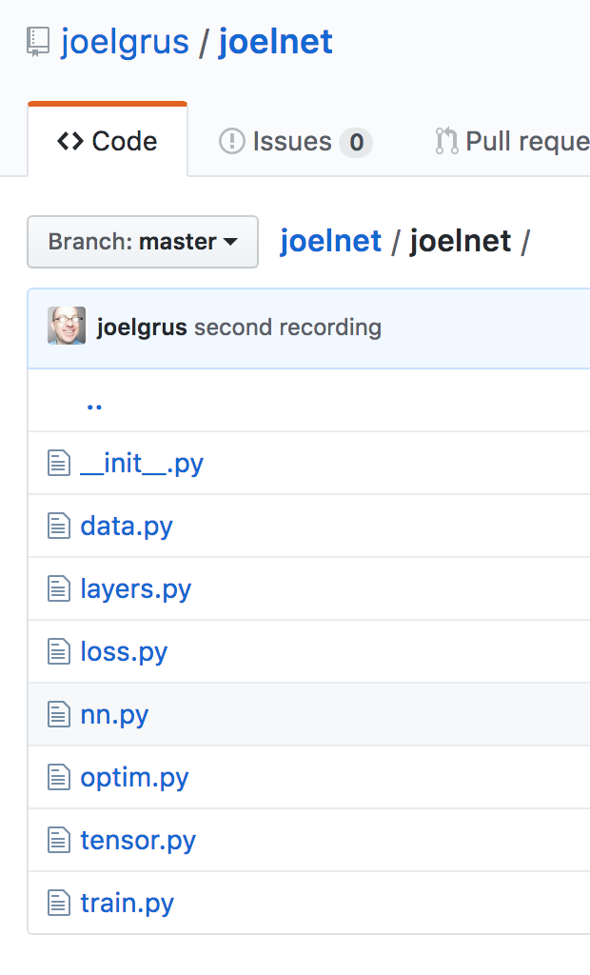
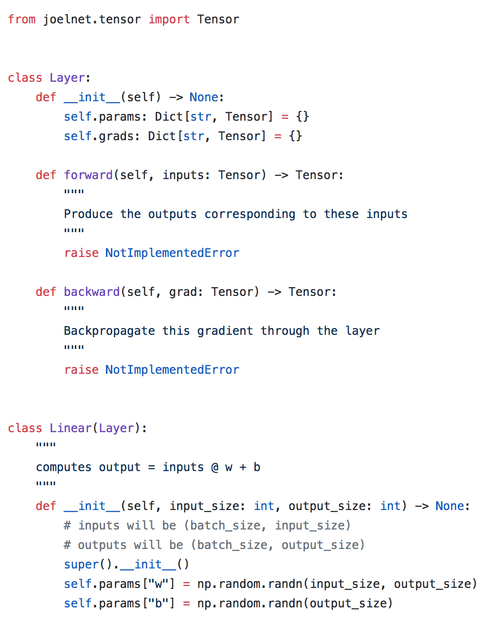
modularity
@joelgrus #jupytercon
Notes:
here's the code from my famous "livecoding a deep learning library" demonstration
without going into details, you'll notice how I create a module for each concept
and make interfaces and classes
it's clean and understandable
you can write tests for it
you can reuse it in other projects
this is something I code from scratch in an hour, so you can't tell me it's too slow to write your code this way
https://media.giphy.com/media/xUA7b0Klw8Wfor7FWo/giphy.gif

Slide 56

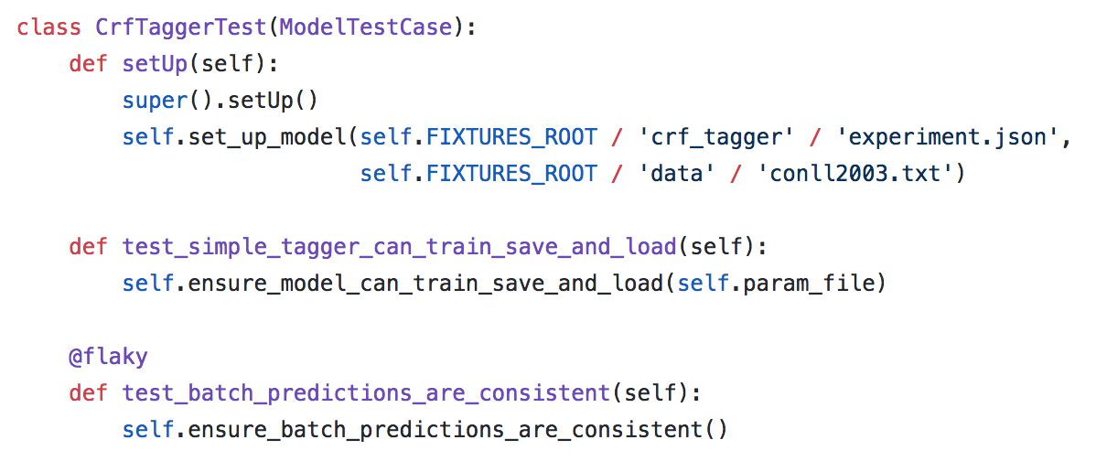
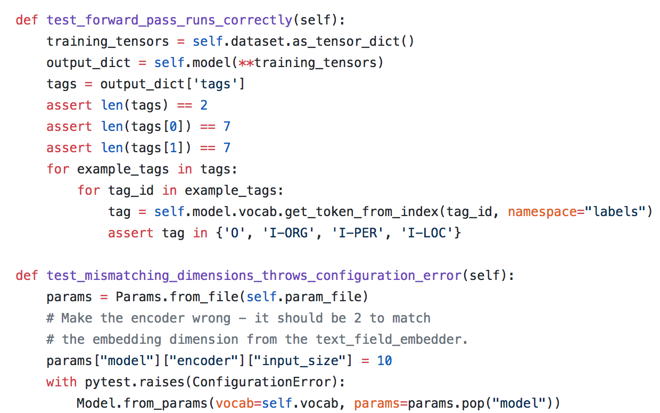
testability
@joelgrus #jupytercon
Notes:
how do you know your code is correct? you write tests for it
how do you know your code stays correct after you make changes to it? you run the tests
is this important for scientific code? my god yes.
how do you write tests for code that's in a notebook? not easily
https://i.embed.ly/1/image?url=https%3A%2F%2Fmedia.giphy.com%2Fmedia%2FMJO2n6UT6LGGA%2Fgiphy.gif&key=a19fcc184b9711e1b4764040d3dc5c07

Slide 57

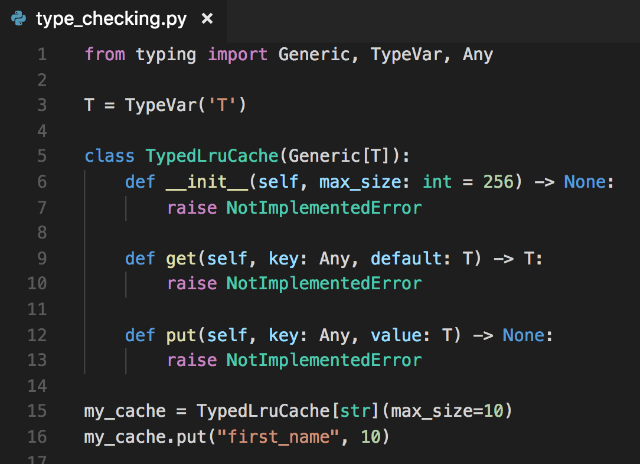
@joelgrus #jupytercon
Notes:
you probably don't write your python with type annotations like this
and you probably don't use mypy to type check your code
partly because I don't lecture you enough about it
partly because notebooks aren't really helpful for this code flow
but you should
if you're curious, come talk to me, mypy is pretty much my favorite subject

Slide 58

@joelgrus #jupytercon
Notes:
this is not cheap talk
I work on a deep learning library for NLP researchers
the last thing we want is for people to do bad science using our platform
so we test the hell out of it

Slide 59
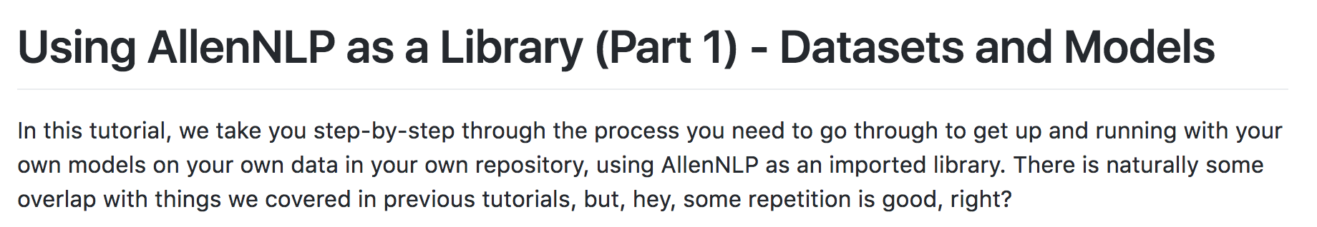
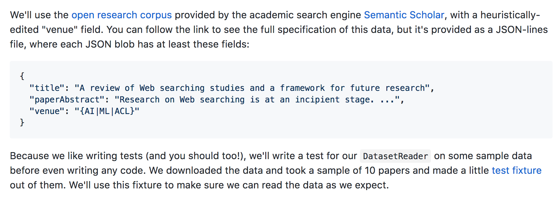
@joelgrus #jupytercon
Notes:
and we tell our users to test the hell out of their code
even though they're just "doing experiments"
in fact, our tutorials include writing unit tests

Slide 60

notebooks are way less helpful than my text editor
@joelgrus #jupytercon
Notes:
put aside all the hidden state and bad habit stuff.
coding in a notebook is not that helpful an experience
and this is one of those things where if you only ever code in notebooks, you might not know what you're missing
https://media.giphy.com/media/3ohzdUpoRv0VAOX8sg/giphy.gif

Slide 61
some things are easier demonstrated

Slide 62


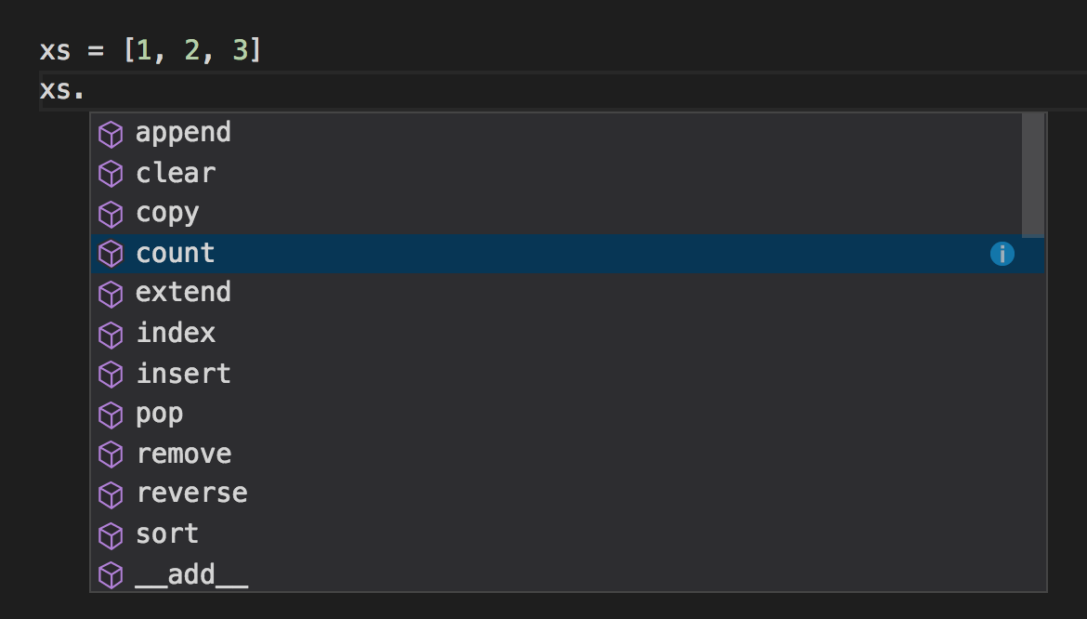
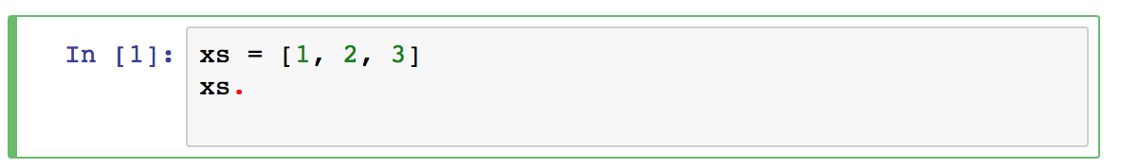
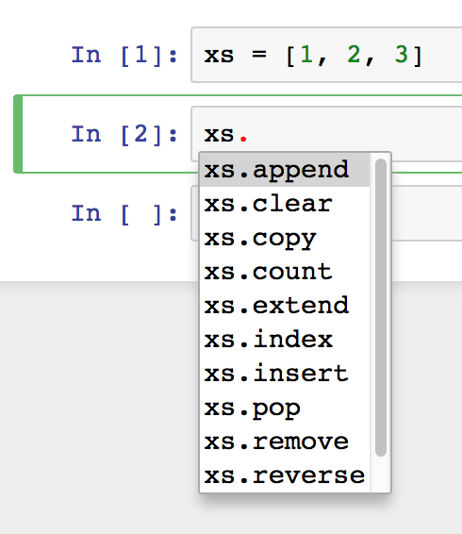
Just run the cell first. And then just press TAB.
@joelgrus #jupytercon
Notes:
my text editor pops up autosuggest as soon as I type the period without me having to do anything
in a notebook I have to first run the cell then in a new cell press tab
this is a small amount of work, but it's more than zero work (and it requires me to work differently) which means that most of the time I won't bother with it

Slide 63
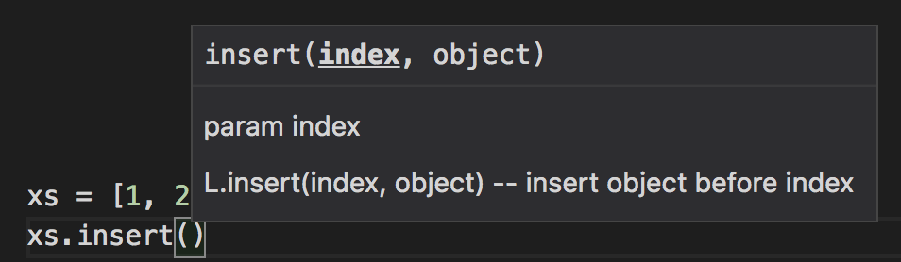
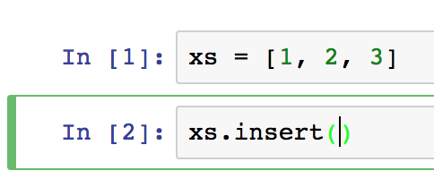
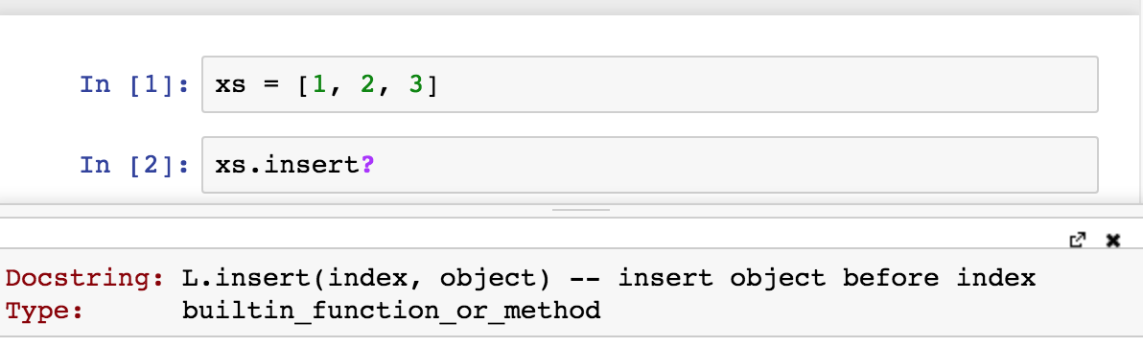
Just replace the parentheses with a question mark. And then just execute the cell
This also "uses up" a computation, so either I have to leave my ignorance there or have "out of order" cells
@joelgrus #jupytercon
Notes:
similarly, my editor pops up the docstring and arguments without me having to do anything
in a notebook I have to delete the parenthesis and add a question mark and execute a cell

Slide 64
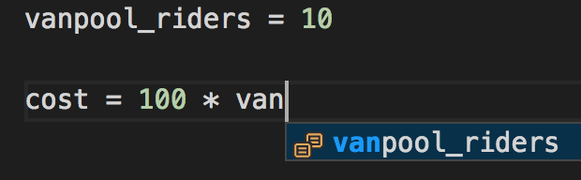
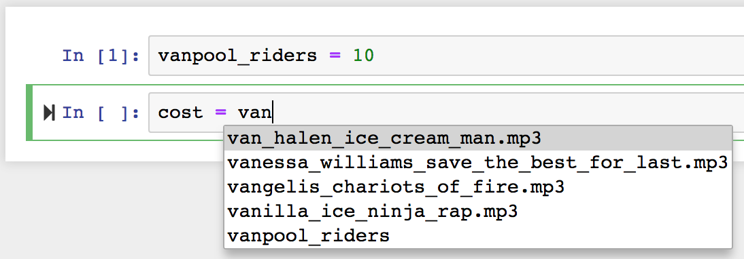
You may not want to use a filename as your variable name, but some people might!
@joelgrus #jupytercon
Notes:
the notebook autocomplete is very strange, as it seems to favor files in the current directory over local variables

Slide 65
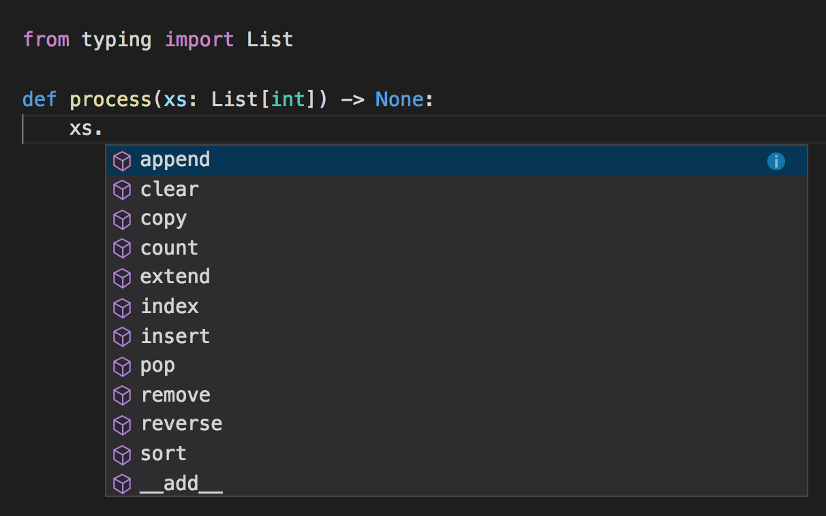

...
@joelgrus #jupytercon
Notes:
my text editor can also look at type annotations (always use type annotations!) and offer me autosuggest based on them
if this is possible in jupyter notebooks, I couldn't figure out a way

Slide 66



...
@joelgrus #jupytercon
Notes:
ok, you don't use type annotations,
here's something you probably do use

Slide 67





I found an extension called "hinterland" that does some of these, but...
questionable autocomplete behavior
enter
still can only autocomplete things that have been executed
which means still can't handle type hints or with blocks
Notes:
I found a "contributed extension" that makes autocomplete better, but
it has a non-obvious name and took several steps to install
and it still is lacking

Slide 68



...
@joelgrus #jupytercon
Notes:
my integrated linter highlights errors and likely errors
again, I don't know how to do this in notebooks

Slide 69




@joelgrus #jupytercon
Notes:
what's that, you want linting in your notebook?

Slide 70

those are the tools that help me be productive and write good code
@joelgrus #jupytercon

Slide 71

You just need to use the next-generation JupyterLab.
@joelgrus #jupytercon
Notes:
maybe I just need to use jupyterlab?
this is what happened when I tried to do tab completion in its text editor

Slide 72

notebooks encourage bad processes
@joelgrus #jupytercon

Slide 73



@joelgrus #jupytercon
Notes:
I saw this on twitter recently
write some of your code in one notebook
and write other of your code in a different notebook
I tried to think up non-evil applications of this
https://i.imgflip.com/2e104c.jpg

Slide 74


@joelgrus #jupytercon
Notes:
but I could only think of evil applications

Slide 75


@joelgrus #jupytercon

Slide 76

notebooks HINDER
reproducible + extensible science
@joelgrus #jupytercon
Notes:
https://www.oreilly.com/ideas/the-intertwingularity-is-near-when-humans-transcend-print-media?utm_medium=content+synd&utm_source=12320&utm_campaign=jpny18&utm_content=intertwingularity+tweet
https://media.giphy.com/media/YWqNggbu9QRhu/giphy.gif

Slide 77

@joelgrus #jupytercon
Notes:
I'm serious

Slide 78

notebooks are a recipe for poorly factored code
@joelgrus #jupytercon
Notes:
don't just take it from me, take it from fchollet
poorly factored code is bad science
notebooks are a recipe for poorly factored code
https://twitter.com/fchollet/status/1018396455533506560

Slide 79

idea:
train a neural network to generate music
this is the true story of an idea that my co-workers and I were kicking around at lunch a couple of months ago, there was more to the idea but this was at the core
@joelgrus #jupytercon
Notes:
here's one example that actually happened to me
some co-workers and I wanted to create a neural network to generate music

Slide 80

"standing on the shoulders of giants, etc., etc."
@joelgrus #jupytercon
Notes:
surely, someone has done this before

Slide 81


😬
was hoping for model.py or models.py or something
was hoping for model.py or models.py or something
@joelgrus #jupytercon
Notes:
but the look of that repo is not promising

Slide 82


nope
pytorch 0.3? 0.4? 0.4.1?
I suppose I could guess based on the commit date
@joelgrus #jupytercon
Notes:
ok, so lots of imports but no versions
is that pytorch 0.3? 0.4? maybe I could guess based on the commit date?

Slide 83



an aside
@joelgrus #jupytercon
Notes:
as an aside, this is what I found when I googled about requirements

Slide 84


model definition
model instantiation (with hard-coded parameters)
more parameters
hard-coded paths
more parameters
training loop
@joelgrus #jupytercon
Notes:
so, again, here's the notebook for training the model

Slide 85
@joelgrus #jupytercon
This code is pretty much impossible for me to use
First, I have to look at the notebooks, manually install all the dependencies, and hope I got the right version
Then either:
I can run it the exact same way on the exact same data (at the exact same paths!), or
I can copy the notebook and try to figure out how to modify it (forcing me to work in a notebook), or
I can do a lot of work to copy and paste the right parts into a module that I can import into my own code
You know, there is a tool called nbconvert

Slide 86

(yes, I am aware of nbconvert)
$ jupyter nbconvert music_generation_training_nottingham.ipynb --to python
still mixes "library" code and "execution" code
still have to go through and perform surgery
still no requirements.txt / unit tests
still few comments :(
@joelgrus #jupytercon
Notes:
nbconvert doesn't really solve my problem

Slide 87
to be perfectly fair
this is someone's fun project
kudos to them for sharing what they did
likely they thought they were being helpful by providing notebooks
what they did was make it semi-possible (but not easy) for me to repeat their exact same code (but only if I have my data at the exact same paths and the right versions of all their dependencies, ¯\_(ツ)_/¯)
while making it very hard for me to build new things on top of their code
again, lots of non-notebook code has these same issues, it's just that notebooks implicitly encourage a workflow that has these issues
@joelgrus #jupytercon

Slide 88

but imagine...
@joelgrus #jupytercon
Notes:
but imagine

Slide 89

but imagine...
@joelgrus #jupytercon
a requirements.txt (possibly even a Docker image) indicating exactly what dependencies I need
clean, parameterizable load_data.py and model.py with good documentation and unit tests (but I repeat myself)
an easy way to programmatically specify model parameters, data paths, and so on
a run_experiment.py script that replicates exactly the original result, and that can be tweaked in obvious ways to run novel variants
YOU

Slide 90



@joelgrus #jupytercon
Notes:
this is how we do things on my team
here's the code for training an ELMo model
this is the code behind the ACL best paper
it tells you exactly what to install, how to run it, and how to supply your own parameters

Slide 91

notebooks make it hard to collaborate across mediA
@joelgrus #jupytercon
Notes:
once code is in a notebook, it's nontrivial to get it out of a notebook
https://media.giphy.com/media/86X7yW81ycvN6/giphy.gif

Slide 92

the scene: pytorch slack, #beginner channel
@joelgrus #jupytercon
Notes:
so, I hang out on the pytorch slack, usually in the #beginner channel

Slide 93

"It never hurts to help!"
@joelgrus #jupytercon
Notes:
as somewhat of a beginner, I am familiar with beginners mistakes
and I know how to distill them down to their essences

Slide 94

I imagine it took you a few tries to produce that, a notebook would have made it easier
@joelgrus #jupytercon
Notes:
so I create a minimum viable reproduction in ipython and then paste it into slack
but yes it took me a few tries to get the reproduction right

Slide 95

ok, I guess I could do that IN a notebook
@joelgrus #jupytercon
Notes:
sure, I'll try doing it in a notebook

Slide 96
but how to copy and paste into slack?
@joelgrus #jupytercon
Notes:
I just need to copy and paste the results into slack

Slide 97


select all -> copy -> paste
@joelgrus #jupytercon
Notes:
this is the first thing I tried
it includes header cruft
and makes no distinction between inputs and outputs

Slide 98
select cells -> edit -> copy cells -> paste
doesn't seem to do anything outside of the notebook
that is, when you go to Slack, there's nothing in the clipboard
@joelgrus #jupytercon
Notes:
this was the second thing I tried
it didn't actually do anything

Slide 99

select cells -> copy -> paste
@joelgrus #jupytercon
Notes:
this is the third thing I tried
it copied the inputs but not the outputs

Slide 100

basically, I have no idea how to copy and paste code + outputs from a notebook into slack
as far as I can tell, in JupyterLab even the "ugly" versions don't work!
@joelgrus #jupytercon
Notes:
what was easy to do in ipython was not easy in notebooks

Slide 101

this may seem frivolous, but I spend a lot of time debugging people's python issues via slack
@joelgrus #jupytercon
Notes:
and this is something I do a lot

Slide 102

same thing for github issues / code reviews
@joelgrus #jupytercon
Notes:
similarly, I paste a lot of code into github discussions

Slide 103
one other nuisance that I discovered when working on this example!
@joelgrus #jupytercon
Notes:
one more thing

Slide 104

kernel -> restart and run all
error was expected
(and is part of what I want to demonstrate)
but halts execution
@joelgrus #jupytercon
Notes:
if I restart the kernel and run all, execution stops as soon as it encounters the (expected) error

Slide 105



@joelgrus #jupytercon
Notes:
it turns out there is a way to get execution to keep going
it's kind of complicated

Slide 106

@joelgrus #jupytercon
Notes:
and in particular it would mean I can only share the notebook with people who have gone through all these steps

Slide 107

notebooks make it easy to teach poorly
@joelgrus #jupytercon
Notes:
people use notebooks as teaching tools
but it's so easy to make bad teaching notebooks
https://media.giphy.com/media/LweK4Ma6Chp8k/giphy.gif

Slide 108

@joelgrus #jupytercon
Notes:
so I get that it's cool that your tutorial includes a whole bunch of runnable code
but I disagree that a whole pile of runnable code makes for a good tutorial
or even that your tutorial is somehow better on account of you being able to run every code snippet

Slide 109

@joelgrus #jupytercon
Notes:
this is the official jupyter list of notable notebooks
these are the introductory tutorials that the jupyter people thought were worth highlighting
there's one that's a python tutorial
so I bet it's a pretty good python tutorial that showcases the power of notebooks and the beauty of Python, right?

Slide 110

@joelgrus #jupytercon
Notes:
the whole tutorial is like this

Slide 111

@joelgrus #jupytercon
Notes:
this is the canonical shift-enter tutorial
https://frinkiac.com/video/S07E07/GCeReNOqm3KO3z1TlpUYE0Ngxug=.gif

Slide 112



@joelgrus #jupytercon
Notes:
calling this a "tutorial" is generous
it's some executable cells with cursory explanations above them
and yet this was listed as one of the four "Introductory Tutorials" on the official list of curated "notable" notebooks
if not for the executable cells, no one would pay attention to a tutorial like this, let alone list it as notable

Slide 113

notebooks make it hard for me to teach well
@joelgrus #jupytercon
Notes:
in addition to making it easy to teach poorly, notebooks make it hard to teach well
https://media.giphy.com/media/ueL9odWMdyJr2/giphy.gif

Slide 114


this is from a real book
written by me
Data Science from Scratch
available wherever books are sold
OK, not exactly as we speak.
2nd edition being written as we speak
@joelgrus #jupytercon
Notes:
this is from a real book (written by me)

Slide 115
You should make a notebook version of your book.
Sure, I'll give it a try!
@joelgrus #jupytercon
Notes:
occasionally people will tell me that I should make a notebook version of my book

Slide 116
this is from a real book
written by me
Data Science from Scratch
available wherever books are sold
OK, not exactly as we speak.
2nd edition being written as we speak
@joelgrus #jupytercon
Notes:
I'm developing a class representing a database
the whole thing would be several pages of code if I dumped it all at once
so I introduce one method at a time and explain it and show how it works

Slide 117

Well, your book shouldn't split the class into multiple pieces like that
@joelgrus #jupytercon
Notes:
but the requirement that every code snippet be runnable is incompatible with the way I want to write my book
sometimes people tell me that I should instead write my book in such a way that every snippet is runnable
(usually these are people who have not written books themselves)

Slide 118
You'd rather I dump several pages of code at the reader all at once, then refer back to it bit by bit?
...
@joelgrus #jupytercon
Notes:
but I hate it when books dump hundreds of lines of code on you all at once
and I made an extremely deliberate decision not to write mine that way

Slide 119

It's not just me!
@joelgrus #jupytercon
Notes:
I'm not the only one who wants this
https://github.com/jupyter/notebook/issues/1243

Slide 120



@joelgrus #jupytercon
Notes:
you can use "jupyter dynamic classes" if you just percent percent add to

Slide 121


@joelgrus #jupytercon
Notes:
or, this one is clever, you can keep redefining a class as a subclass of itself over and over again, adding a new method each time

Slide 122


this was also suggested
@joelgrus #jupytercon
Notes:
it was also suggested just to manually stick the new methods on the class

Slide 123
every one of these requires presenting unnatural code to my readers, solely to appease the notebook gods
@joelgrus #jupytercon
Notes:
every one of these suggestions require me to present "unnatural" code
I use code to communicate clearly

Slide 124

simpler examples too
this is not a real variable, which means this snippet isn't executable
this example would not be improved by actually defining that variable
Notes:
here's a simple example (also from my book) about why you might want to use a set

Slide 125
what I do instead
@joelgrus #jupytercon
Notes:
so what do I do?

Slide 126

markdown tutorials
and
docs
@joelgrus #jupytercon
Notes:
I write my tutorials in markdown
they look almost the same
this means you can't run them line by line by pressing control-enter
which is fine, I don't want that
and it means I'm forced to *tutor* you

Slide 127


vscode + ipython console
@joelgrus #jupytercon
Notes:
write code in the editor
run it in the console
repeat

Slide 128
demo
(time permitting)
@joelgrus #jupytercon

Slide 129
how you could win me over
@joelgrus #jupytercon
Notes:
so, is there anything you could do to win me over?

Slide 130

@joelgrus #jupytercon
Notes:
the jake plan would treat notebooks as immutable, append-only documents
this is how physical lab notebooks work (or are supposed to work)
but I suspect you would hate that

Slide 131

@joelgrus #jupytercon
Notes:
this is a tiny thing

Slide 132

IDE-style autocomplete
@joelgrus #jupytercon
Notes:
I love my autocompletes, and I feel like I'm coding with half my brain when I'm deprived of them

Slide 133

real-time typechecking and linting
@joelgrus #jupytercon
Notes:
I want my editor to catch my mistakes as I make them

Slide 134

a better story around dependency management
@joelgrus #jupytercon
Notes:
if people are going to share their code in notebooks, they should have to tell me what versions of things they're using
(yes, a lot of non-notebook code is very bad about this too)

Slide 135

first-class support for refactoring code out of notebooks into modules
@joelgrus #jupytercon
Notes:
and finally we should make it as easy as possible (and strongly encourage people) to factor their code into modules
https://media.giphy.com/media/q7UMby9U8hW3C/giphy.gif

Slide 136

the reality is
@joelgrus #jupytercon
you're not going to provide me all these things
I'm not going to switch to notebooks
but hopefully I've challenged you to think about
how your tools limit you
how to write better software
how to teach better
how to practice better science
how different workflows could make your life easier
some ways that you could make notebooks better
Notes:
those things are probably not going to happen
instead, you're going to keep liking notebooks for the reasons you like them
I'm going to keep not liking them for the reasons I don't like them
but hopefully my criticisms can help you in some way

Slide 137
in conclusion
@joelgrus #jupytercon
Notes:
in conclusion
I hope this was not an unhelpful way to spend time
and I hope you learned something about how to do better science and write better code and use your tools more effectively

Slide 138

please come to my next talk:
"I don't like that slideshow program where sometimes the next slide is RIGHT and sometimes the next slide is DOWN"
@joelgrus #jupytercon
Notes:
make sure to come to my next talk

Slide 139

thanks for coming!
will tweet out slides: @joelgrus
check out my book Data Science from Scratch
very infrequently updated blog: joelgrus.com
podcast: adversariallearning.com
livecoding videos: youtube.com/user/joelgrus
tell me why I'm wrong: joelgrus @ gmail
and of course I have a SoundCloud 😂😂😂: soundcloud.com/joel-grus
@joelgrus #jupytercon
Notes:
thanks for coming!

Slide 140
appendix (rejected memes)
@joelgrus #jupytercon

Slide 141

PYTHON NEWBIES
JUPYTER NOTEBOOKS
@joelgrus #jupytercon
@joelgrus #jupytercon

Slide 142

@joelgrus #jupytercon

Slide 143

@joelgrus #jupytercon
Notes:
https://i.imgflip.com/2ajwi5.jpg

Slide 144
@joelgrus #jupytercon
UNTITLED25.IPYNB
UNTITLED24.IPYNB
Notes:
you know you have folders full of these
even I have folders full of these

